Slide 1


Our Behaviour Policy
Building strong futures together

Slide 2
To keep us safe and happy at Sandal Castle School, we need a set of rules that EVERYONE will follow:
Our 4 new School Rules:
Be safe
Be respectful
Be ready
Be responsible

Slide 3
At Sandal Castle School this means…
Be safe
Walking calmly around school
Safe hands and feet- not hurting children or adults
Not throwing any equipment
Not leaving class without permission
Being hygienic- washing hands
Lining up sensibly, quietly and calmly
4 chair legs on the floor

Slide 4
At Sandal Castle School this means…
Be respectful
Listening to others when they talk
Waiting for your turn
Using good manners
Look at people when they are speaking
Be tolerant of difference; religions and opinions
Following instructions from adults
Look after our environment and equipment
Holding doors open for others
Not arguing- be aware of your tone of voice

Slide 5
At Sandal Castle School this means…
Be ready
Going to the toilet at the correct time; not during lessons
Good learning behaviours; good sitting, listening and looking
Getting a drink at the correct time
Independent thinking/problem solvers
Magnet eyes; not fiddling or day dreaming
Correct equipment: PE kit, coat, bag. Swimming kit, homework, reading book

Slide 6
At Sandal Castle School this means…
Be responsible
Own your actions and accept the consequences
Walking calmly around school
Be a good ambassador; at school and at home
Take pride in your work and have a good work ethic
Lead by example
Do your homework with pride and hand it in, on time
For yours and others’ safety

Slide 7

What happens if I make good behaviour choices?
Every week, our House Captains will collect the points from your class and we will reveal the winner in Friday’s Collective Worship!
You will be placed into a house team. There are four teams called: York, Warren, Clifford, Rutland.
Every half term, you will have the opportunity to swap your house points for prizes and certificates!
When you follow our school rules, you will earn house points for your team!

Slide 8

What will happen in class?
At the beginning of every half term all your names will be stuck on a golden star in your class.
2. If you don’t follow our school rules, staff members will say to you: ‘You are _________. This is your first warning to make good choices”

Slide 9

3. If you continue to display poor behaviour choices, a staff member will say to you: ‘You are continuing to __________. This is your second warning to make good choices. Please move your name onto the amber traffic light”
Sadly, this now means that you cannot return to the golden star over the half term ☹.
Your name will sit on the green traffic light until the new half term.

Slide 10
5. You may be asked to leave the classroom, or speak to a member of SLT.
6. You will be expected to attend a same day inclusion. This means that you can start a fresh, every day! ☺
4. If you continue to make the poor behaviour choices, the staff member will say to you: “You have continued to ________ . This is your final warning, please move your name to red.”

Slide 11
What is an Inclusion?
When you get a red you will have to do a same day inclusion. This will happen in a classroom with a member of SLT.
In the inclusion you will talk to the staff member about your poor behaviour choice and undergo some ‘restorative practice’.
Your parent will also be informed about your inclusion and the reason for the red.
What happens when I get more than one red in a half term?

Slide 12
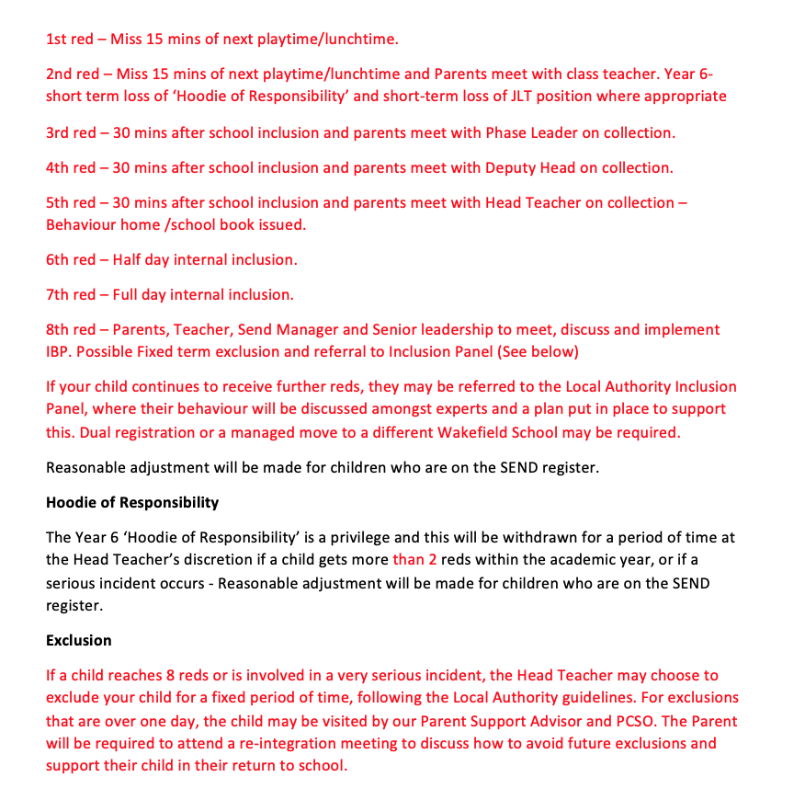

Slide 13
Instant Reds!
Sadly, some instances of behaviour may be considered so severe that the warning system isn’t used. In this case, a red would be given instantly.
This is when an instant red will be given:
Intentional racist or homophobic language
Swearing
Hurting other children or adults
Damaging school property (you will get a bill for this!)
Stealing
Lying
Spitting
Intentional inappropriate touching

Slide 14
‘Star Treat’ Time
At the end of every half term, all the children whose names are on the golden star will enjoy a star treat!
School Council will help us choose each half term’s treat! ☺
Sadly, the children whose names are on the green traffic light, won’t get to access this treat. ☹

Slide 15
Other exciting pieces of news:
Our Year 6’s children will have ‘hoodies of responsibility after the Easter holidays!
However, they will be taken away for a period of time if you get 2 reds or more. You will have to earn your hoodie of responsibility back.
Júnior Leadership Team- We are preparing for a Head of Behaviour who will help us with our new policy.
It could be you! ☺

Slide 16
Any Questions?
Building strong futures together

