Slide 1

Welcome to Sandal Castle VA Primary School
Open Event
Wednesday 19th November 2025

Slide 2
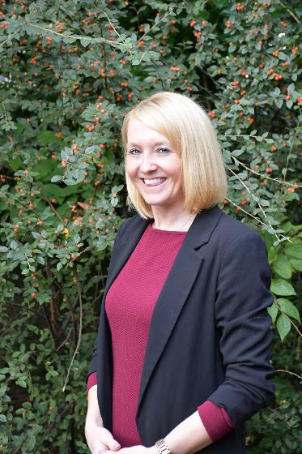
Building Strong Futures Together
We are proud to provide a happy, caring and safe environment for our children. We work very hard to ensure that your child’s experience of school is a positive one, which encourages a love of life long learning, and togetherness.
Mrs Butterworth
Headteacher

Slide 3
OfSTED January 2025
" Pupils enjoy attending this welcoming, friendly school. They are happy and safe. They know that adults have their best interests at heart.
Pupils understand the school rules and meet the high expectations set in class."

Slide 4
OfSTED January 2025
The new leadership team has driven rapid and sustained change in all areas, with skill and determination. As a result, the education provided is having a positive impact on pupils’ learning.
Staff are extremely positive about the support they receive from leaders. Governors are aware of their statutory responsibilities. They use their skill and experience to provide support.

Slide 5
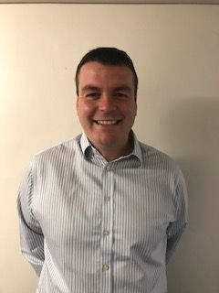
Our School Primary Vision
At Sandal Castle Primary School we build strong futures together. We celebrate and prepare our inclusive community by providing the education and experiences needed, as the building blocks for foundations for life. We empower everyone to be successful, resilient and self-aware global citizens. Together, in God’s love, we nurture hearts, minds and spirit, to equip everyone with wisdom, character and hope, in order to flourish.
Mr Mcfarlane
Deputy Headteacher

Slide 6
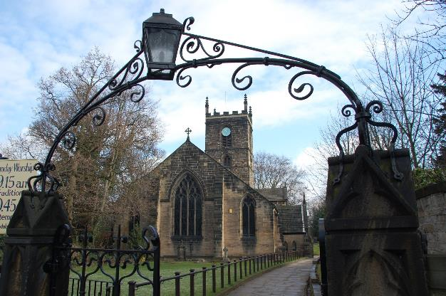
Community Connections
We are very proud of our church community links and we visit St Helen’s church regularly throughout the year.
However, we believe at Sandal Castle that we are a family that welcome all faiths and cultures.

Slide 7
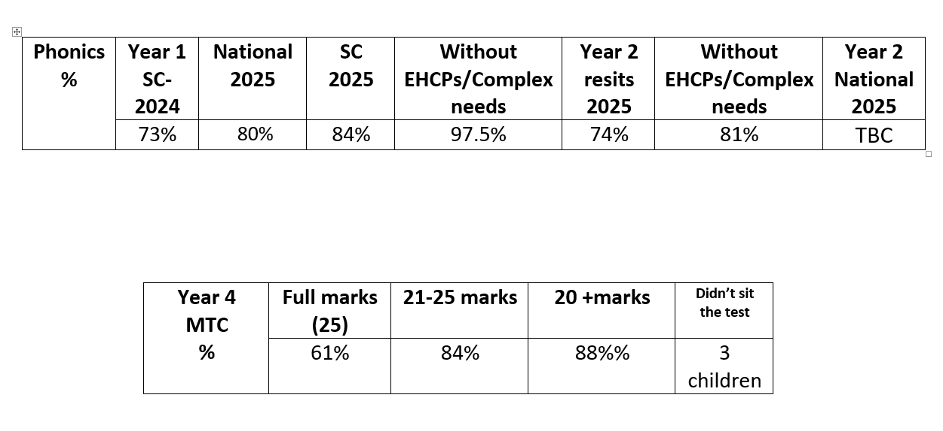
Our Data Profile

Slide 8
Our Strong Parent/Carer Links...
We welcome strong links with our parents to support our children's educational journey.
During each year, you will be invited to class assemblies and Aspire afternoons. We also hold Services at St. Helen's Church three times a year for Harvest, Christmas and Easter, where we hope you will join us!

Slide 9
Good Attendance Matters!
Our school aims to meet its obligations in regard to school attention by:
Promoting good attendance and reducing absence, including persistent absence
Ensuring every child has access to full-time education to which they are entitled
Acting early to address patterns of absence
To this end, we strive to make our school a happy and rewarding experience for all children.
Attendance awards and treats throughout the school year.

Slide 10
Uniform
We are very proud to be part of team Sandal Castle and so all children from foundation to year 6 wear the same uniform.
More information on colours and items can be found on the school website.
Items can be with or without the school logo and can be purchased anywhere.
Some parents like to use the following supplier: www.brigade.uk.com.

Slide 11
A typical day at Sandal Castle
Fun begins at 8:45am
Lunches are staggered from 11:30
Home time 3:15pm
We usually have a number of extra- curricular clubs running after school until 4:15pm on most evenings.

Slide 12
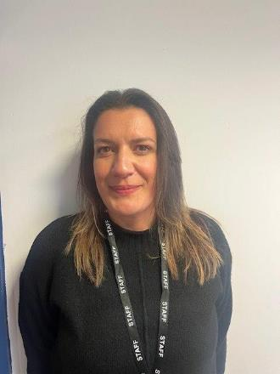
Wrap around care at Sandal Castle
Our Wrap around Care is led by Miss Ferreira and her amazing team!
Sandal Sunrise breakfast club opens daily at 7:30am £4.50 per session
Sandal Stars after school club daily
3:15pm – 4:15pm £4.50
4:15pm 6pm £7.50
3:15pm 6pm £10

Slide 13
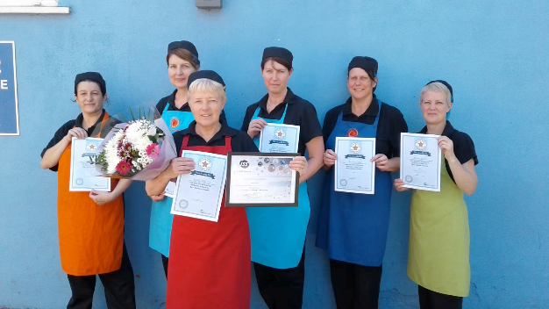

School Meals
Children love school lunches at Sandal Castle. We have a wonderful award winning catering team, ISS, who ensure lunches are healthy, delicious and leave you wanting more!
Please visit our food stall for a taste of school lunches and to see some example menus.

Slide 14
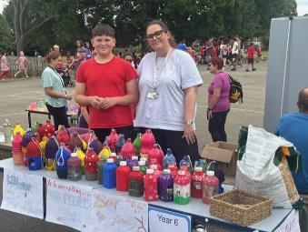
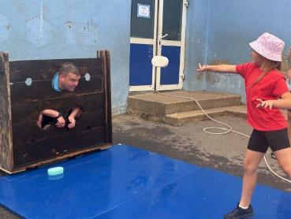
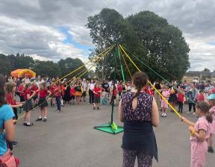
Parent Teacher Association (PTA)
We have a wonderful PTA at Sandal Castle. The PTA hold a range of different events throughout the year including spooky movie night, valentines disco and summer fayre. The children love these events and they also raise vital school funds for extra special activities.
If you are interested in joining the PTA to support school, please see Miss Egley.

Slide 15
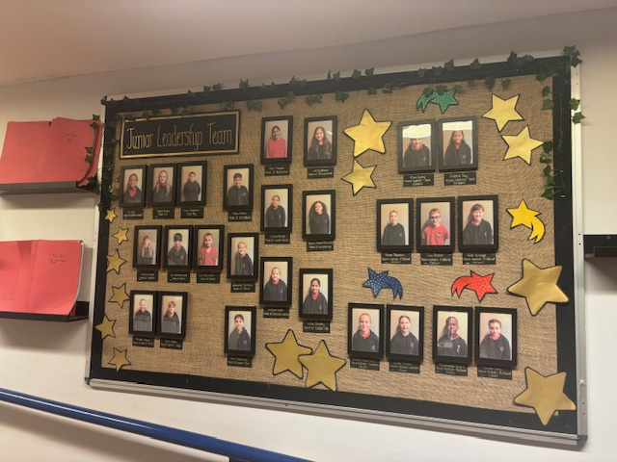
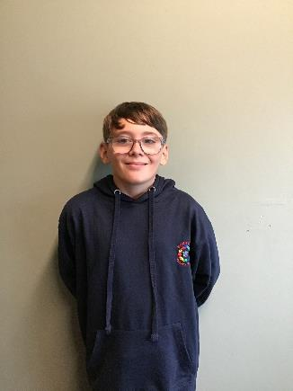
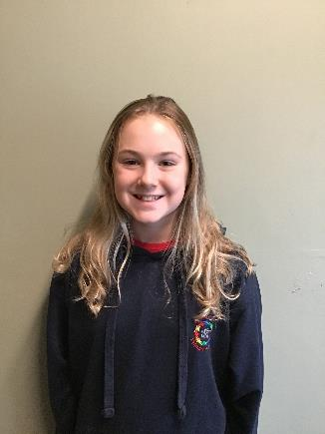
Junior Leadership Team

Slide 16
Early Years Foundation Stage
At Sandal Castle we have 3 foundation classrooms
All classrooms have access to our outdoor area which is getting a complete upgrade in February 2026.
We use Read Write Inc, Drawing Club, Mastering Number and Magic of Stories to help us with our learning.
All learning is rooted in our children’s interests and needs.

Slide 17
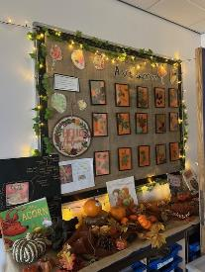
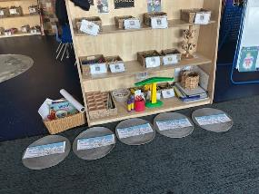
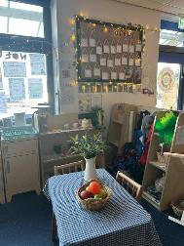
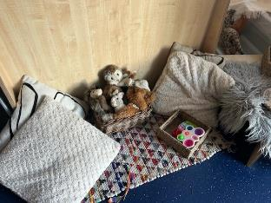
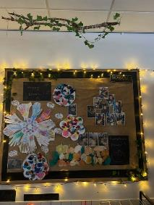
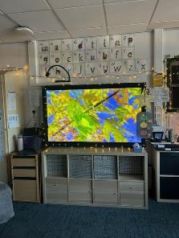
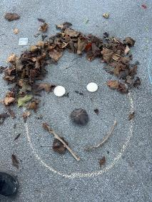
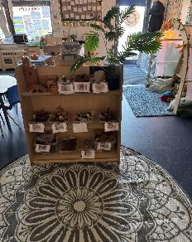
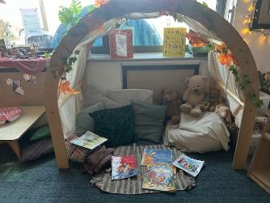
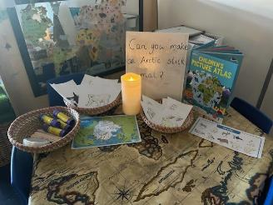
Early Years Foundation Stage

Slide 18
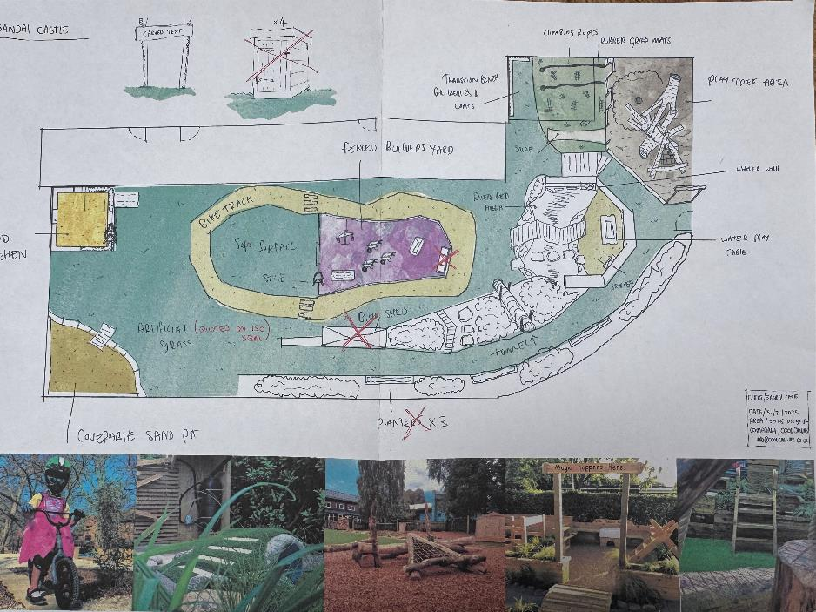
New EYFS Outdoor Area

Slide 19
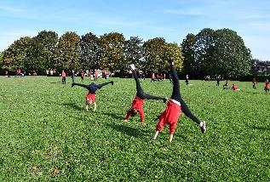
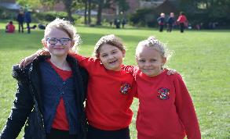
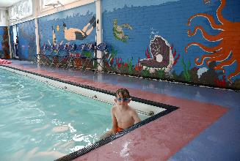
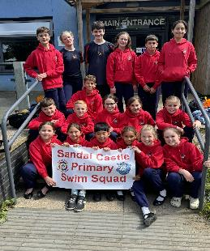
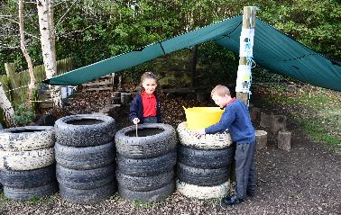
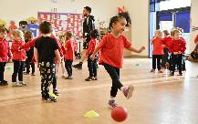
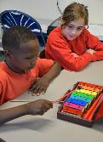
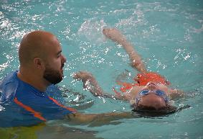
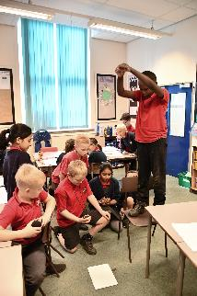
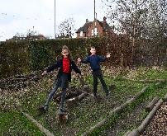
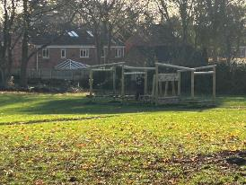
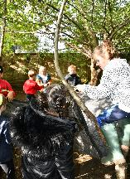
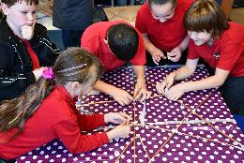
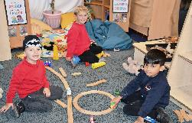
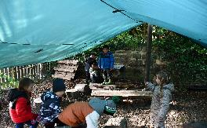
Why choose Sandal Castle

Slide 20
Building Strong Futures Together
Thank you for attending our open event today. We hope to see you in the summer for our new parent event.

