Slide 1

How far will you climb up the gems?
Diamond Dash

Slide 2

To achieve Topaz you will need to be able to count I multiples of:
2, 5 and 10.
You can do each times table at once.

Slide 3

To achieve Emerald you need to know your:
2x, 5x and 10x tables.
You have a sheet to complete.

Slide 4
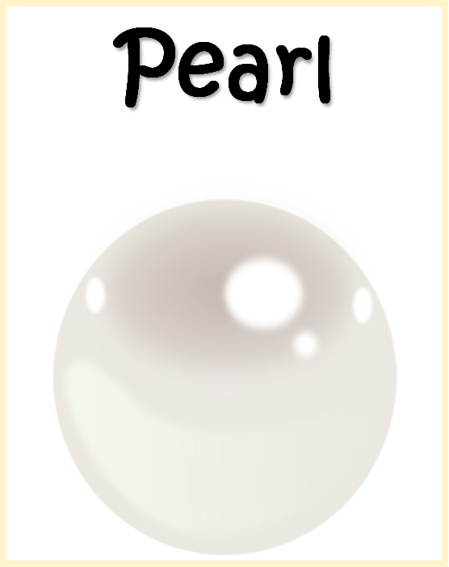
To achieve Pearl you need to know your:
2x, 5x and 10x tables and division facts.
You have only 5 minutes to complete the sheet.

Slide 5

Ruby
To achieve Ruby award you need to know your:
2x, 3x, 4x, 5x and 8x tables and division facts.
You have only 5 minutes to complete the sheet.

Slide 6
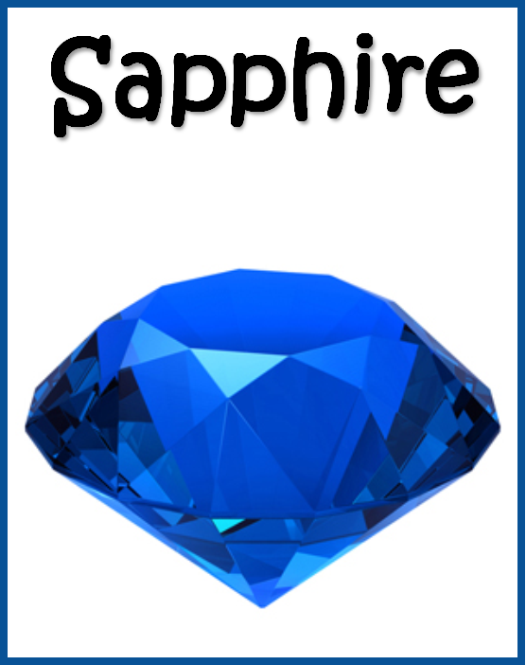
To achieve Sapphire award you need to know your:
2x, 3x, 4x, 5x, 6x, 7x, 8x, 11x tables and the division facts.
You have only 6 minutes to complete the sheet.

Slide 7

To achieve Bronze award you need to know:
ALL times tables up to 12x, division facts, square numbers and square roots.
You have only 8 minutes to complete the sheet.

Slide 8

To achieve Silver award you need to know:
ALL times tables up to 12x table, division facts, square numbers and square roots.
You have only 7 minutes to complete the sheet.

Slide 9

To achieve Gold award you need to know:
ALL times tables up to 12x table, division facts, square numbers and square roots.
You will complete this verbally for 2 minutes.

Slide 10
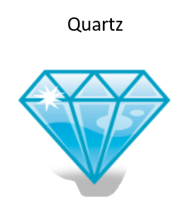
.
To achieve Quartz award you need to know:
ALL times tables up to 12x table, division facts, square numbers and square roots.
You will complete 116 questions in 6 minutes.

Slide 11
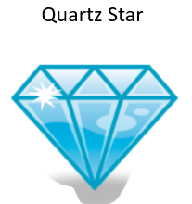
.
To achieve Quartz award you need to know:
ALL times tables up to 12x table, division facts, square numbers and square roots.
You will complete 171 questions in 7 minutes

Slide 12
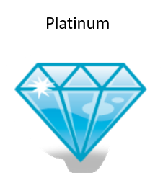
To achieve Quartz award you need to know:
ALL times tables up to 12x table, division facts, square numbers and square roots.
You will complete 171 questions in 7 minutes.

Slide 13


You will complete the sheets from your gem twice per week.
Can you think of any other ways that you can practise your times tables in order to move up a gem?
Here are some suggested and free ways:

Slide 14


